Slide 1
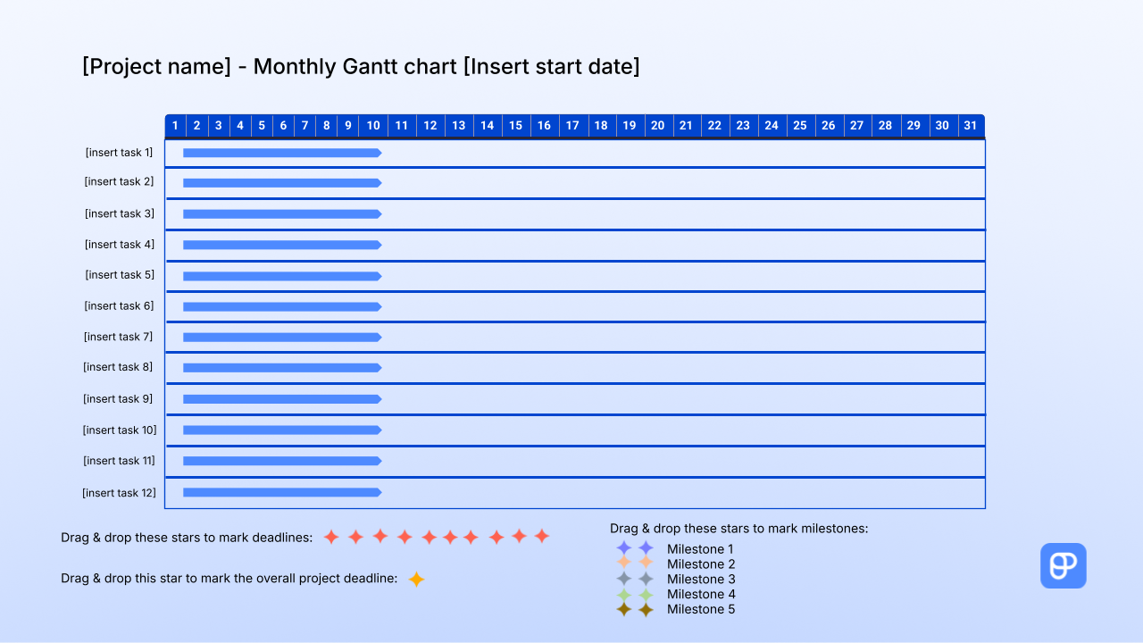

Instructions:
1. Add the project name.
2. Define the tasks.
TASKS:
1. Move the blue arrow representing a task across its column to mark its
position on the chart (i.e., the time when you’ll tackle it).
2. Select and stretch the blue arrow representing a task across its column to mark its duration.
MILESTONES:
1. To set each milestone, select one of the 2 stars and drag & drop it to the desired month on the timeline.
2. Add notes about the milestones next to the remaining star.
DEADLINES:
1. To set a deadline, select a red star and drag & drop it to the desired hour on the timeline.
2. Add notes about the tasks below.
PROJECT DEADLINE:
1. To mark the project deadline, select the yellow star and drag & drop it to the desired hour on the timeline.
PRODUCTIVITY TIP:
Use Plaky to manage your projects more efficiently

Slide 2








[Project name] - Monthly Gantt chart [Insert start date]
1 2 3 4 5 6 7 8 9 10 11 12 13 14 15 16 17 18 19 20 21 22 23 24 25 26 27 28 29 30 31
[insert task 1]
[insert task 2]
[insert task 3]
[insert task 4]
[insert task 5]
[insert task 6]
[insert task 7]
[insert task 8]
[insert task 9]
[insert task 10]
[insert task 11]
[insert task 12]
Drag & drop these stars to mark milestones:
Drag & drop these stars to mark deadlines:
Milestone 1
Milestone 2
Milestone 3
Milestone 4
Milestone 5
Drag & drop this star to mark the overall project deadline:

