Slide 1
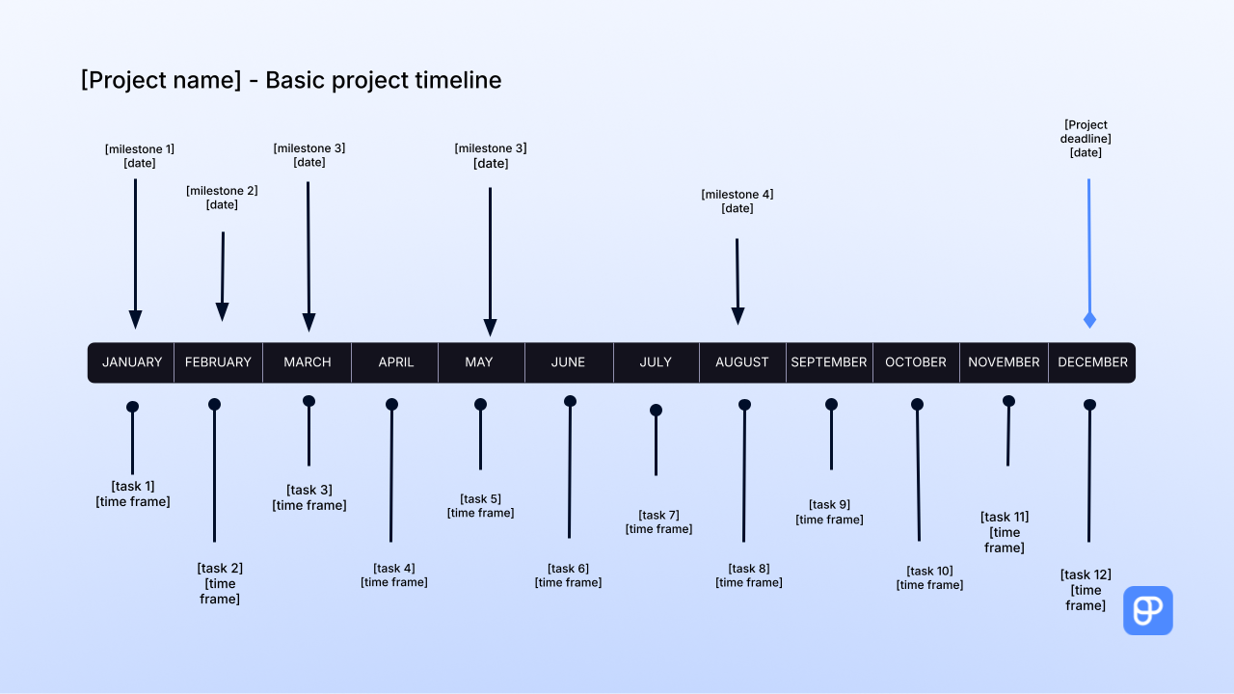

Instructions:
1. Add your project name.
2. Add your milestones and their dates.
3. Add you tasks and the dates when you’re supposed to tackle them (e.g., August 4th - August 10th; 9 am - 12 pm, August 14th).
4. Add your overall project deadline.
MILESTONES:
1. Press SHIFT and select the desired milestone arrow with the text above it.
2. Drag & drop it at the desired place on the timeline.
TASKS:
1. Press SHIFT and select the arrow representing a task and the text above.
2. Drag and drop it at the desired place on the timeline.
PROJECT DEADLINE:
1. Press SHIFT and select the entire project deadline arrow.
2. Drag & drop it at the desired place in the timeline.
PRODUCTIVITY TIP:
Use Plaky to manage your projects more efficiently

Slide 2

[Project name] - Basic project timeline
[Project deadline]
[date]
[milestone 1]
[date]
[milestone 3]
[date]
[milestone 3]
[date]
[milestone 2]
[date]
[milestone 4]
[date]
JANUARY FEBRUARY MARCH APRIL MAY JUNE JULY AUGUST SEPTEMBER OCTOBER NOVEMBER DECEMBER
[task 1]
[time frame]
[task 3]
[time frame]
[task 5]
[time frame]
[task 7]
[time frame]
[task 9]
[time frame]
[task 11]
[time frame]
[task 2]
[time frame]
[task 4]
[time frame]
[task 6]
[time frame]
[task 8]
[time frame]
[task 10]
[time frame]
[task 12]
[time frame]

