Slide 1
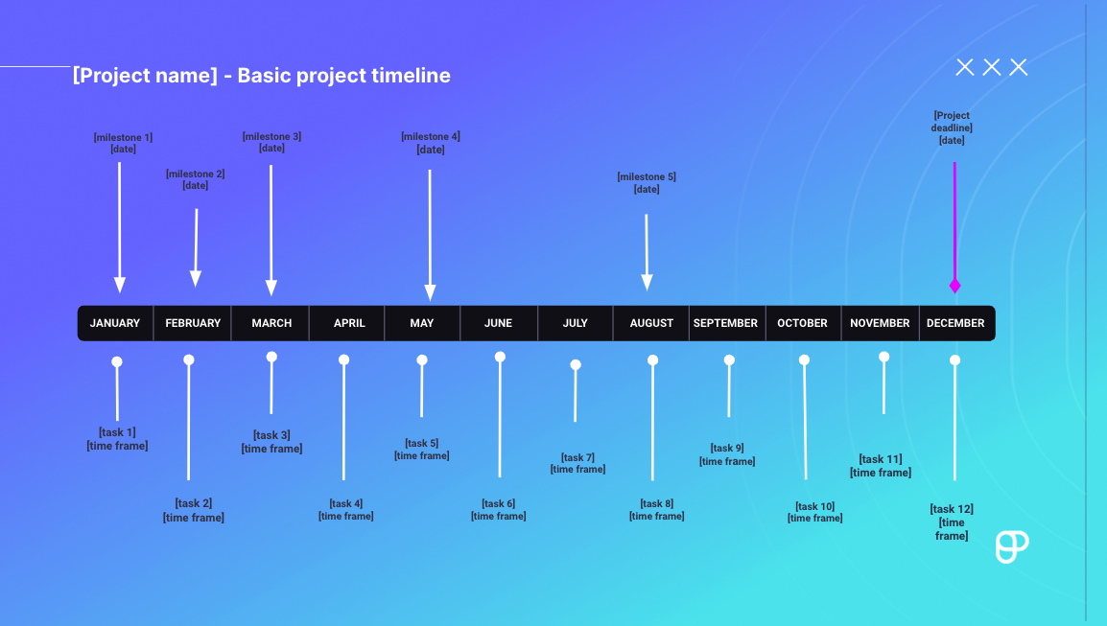
Instructions:
1. Add the project name
2. Add the milestones and their dates 3. Add the tasks and the dates you’re supposed to tackle (e.g. August 4th - August 10th; 9 am - 12 pm, August 14th). 4. Add your overall project deadline
MILESTONES:
1. Press SHIFT and select the desired milestone arrow with the text above it
2. Drag & drop at the desired place on the timeline
TASKS:
1. Press SHIFT and select the arrow representing a task and the text above it
2. Drag and drop at the desired place on the timeline
PROJECT DEADLINE:
1. Press Shift and select the entire project deadline arrow
2. Drag & drop it at the desired place in the timeline
PRODUCTIVITY TIP: Use Plaky to manage your projects more efficiently

Slide 2
[Project name] - Basic project timeline
[Project deadline] [date]
[milestone 1] [date]
[milestone 3] [date]
[milestone 4] [date]
[milestone 2] [date]
[milestone 5] [date]
JANUARY FEBRUARY MARCH APRIL MAY JUNE JULY AUGUST SEPTEMBER OCTOBER NOVEMBER DECEMBER
[task 1] [time frame]
[task 3] [time frame]
[task 5] [time frame]
[task 7] [time frame]
[task 9] [time frame]
[task 11] [time frame]
[task 2] [time frame]
[task 4] [time frame]
[task 6] [time frame]
[task 8] [time frame]
[task 10] [time frame]
[task 12]
[time frame]

