Slide 1
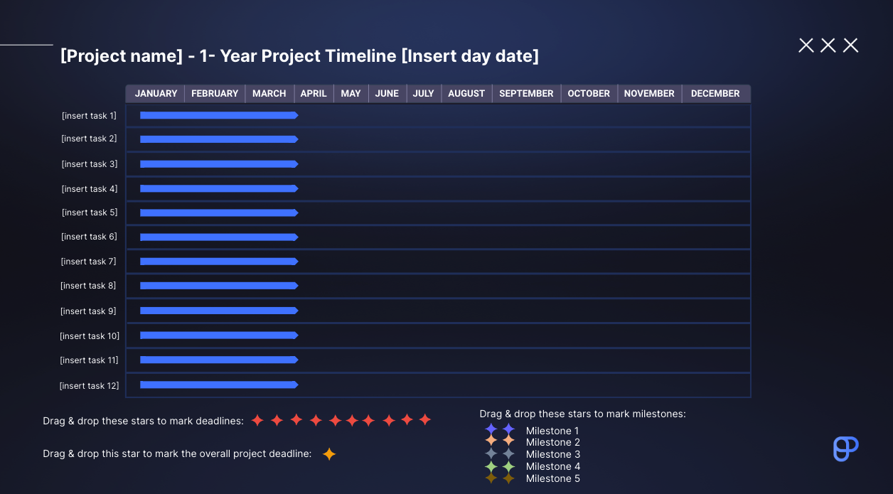
Instructions:
1. Add the project name
2. Define the tasks
TASKS:
1. Move the blue arrow representing a task across its column to mark its position on the chart (i.e. the time when you’ll tackle it)
2. Select and stretch the blue arrow representing a task across its column
to mark its duration
MILESTONES:
1. To set each milestone, select one of the 2 stars, and drag & drop it to the desired
month on the timeline
2. Add the milestone next to the remaining star under the timeline
DEADLINES:
1. To set a deadline, select a red star and drag & drop it to the desired
month on the timeline
2. Add notes about the tasks below
PROJECT DEADLINE:
1. To mark the project deadline, select the yellow star and drag & drop it
to the desired month on the timeline
PRODUCTIVITY TIP: Use Plaky to manage your projects more efficiently

Slide 2
[Project name] - 1-Year Project Timeline [Insert day date]
JANUARY FEBRUARY MARCH APRIL MAY JUNE JULY AUGUST SEPTEMBER OCTOBER NOVEMBER DECEMBER
[insert task 1]
[insert task 2]
[insert task 3]
[insert task 4]
[insert task 5]
[insert task 6]
[insert task 7]
[insert task 8]
[insert task 9]
[insert task 10]
[insert task 11]
[insert task 12]
Drag & drop these stars to mark milestones:
Drag & drop these stars to mark deadlines:
Milestone 1
Milestone 2
Milestone 3
Milestone 4
Milestone 5
Drag & drop this star to mark the overall project deadline:

